Slide 1
REWIRE CYBERSECURITY SKILLS ALLIANCE A NEW VISION FOR EUROPE
Speakers:
Manos Athanatos, Technical University of Crete, Greece
Fotini Georga, LRQA Hellas S.A., Greece
Security BSides Athens
June 29, 2024

Slide 2
Roadmap
Introduction
CyberABILITY Platform
Training - Cyber Range, Online Courses , Certification

Slide 3
Introduction
What is REWIRE about?

Slide 4
Introduction – Main Drivers
"The EU faces a shortage of approximately 348,000 cybersecurity professionals (Home | ISC2) (Digital Skills and Jobs Platform)
"It takes several years to adequately train cybersecurity experts" (Digital Skills and Jobs Platform) (World Economic Forum) .
"Over 55% of enterprises report challenges in recruiting ICT specialists" (The Official Microsoft Blog)
Notes:
driven by increasing cyber threats and rapid digital transformation
exacerbating the skills gap due to the high demand for specialized and up-to-date knowledge
, with countries like Poland, Germany, and Romania seeing particularly high demand growth
"Efforts to address the gap include the European Cybersecurity Skills Framework" and various public-private partnerships aimed at standardizing qualifications and enhancing training programs (Digital Skills and Jobs Platform) (World Economic Forum) .

Slide 5
Introduction – Objectives
Aim of the project:
To develop a Blueprint for the Cybersecurity industry and a concrete European Cybersecurity Skills Strategy
Set up a sustainable sectoral alliance delivering innovative relevant instruments to address cyber-security skills shortages and gaps
Match skills' demand and supply,
Define a new common Cybersecurity Skills Framework,
Notes:
4) including emerging skills and allows training and education institutions to introduce them intro training curricula

Slide 6
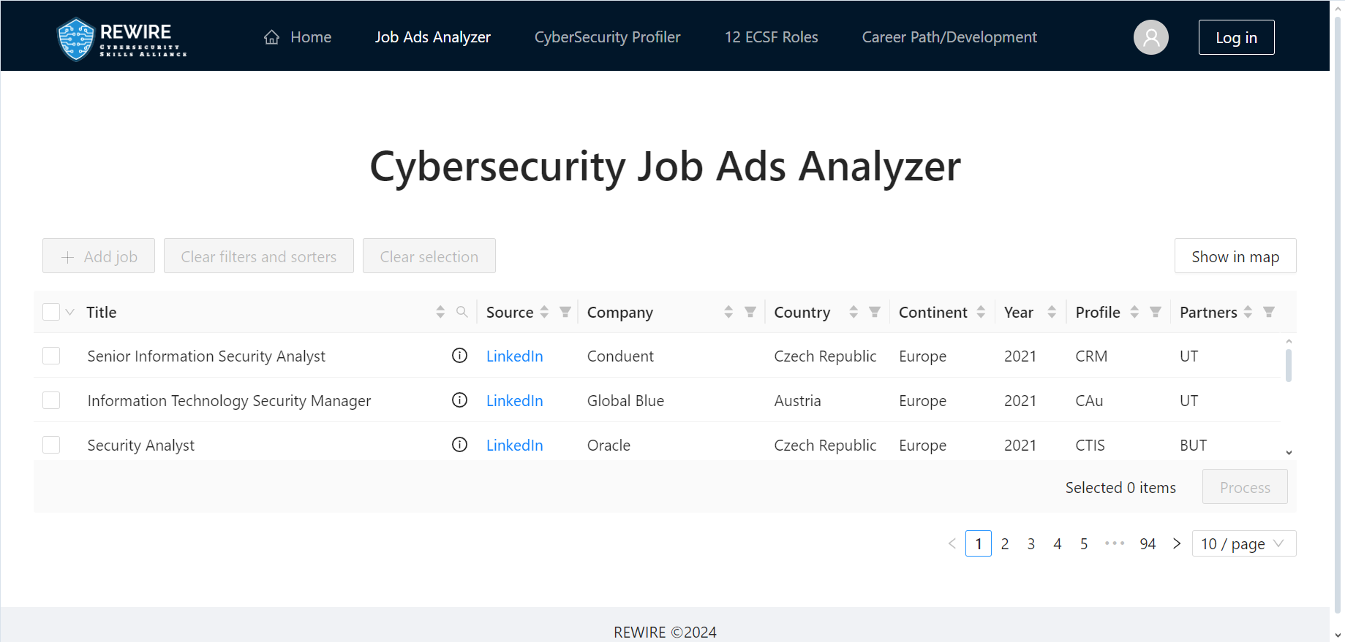
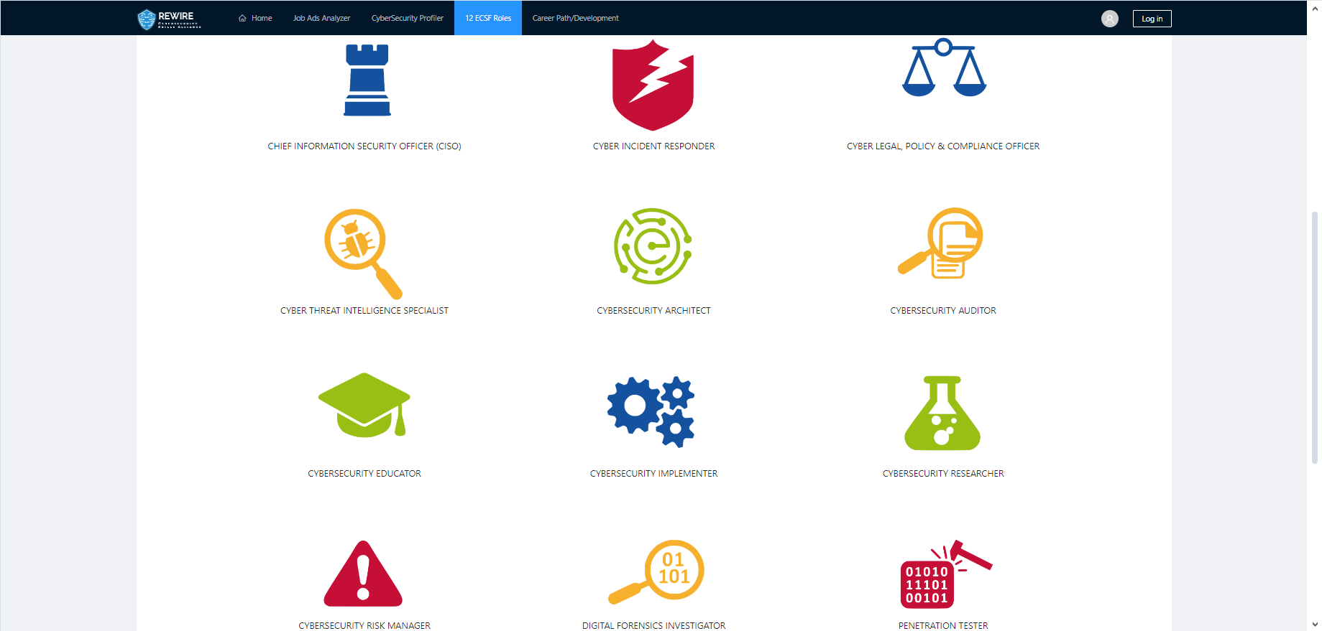
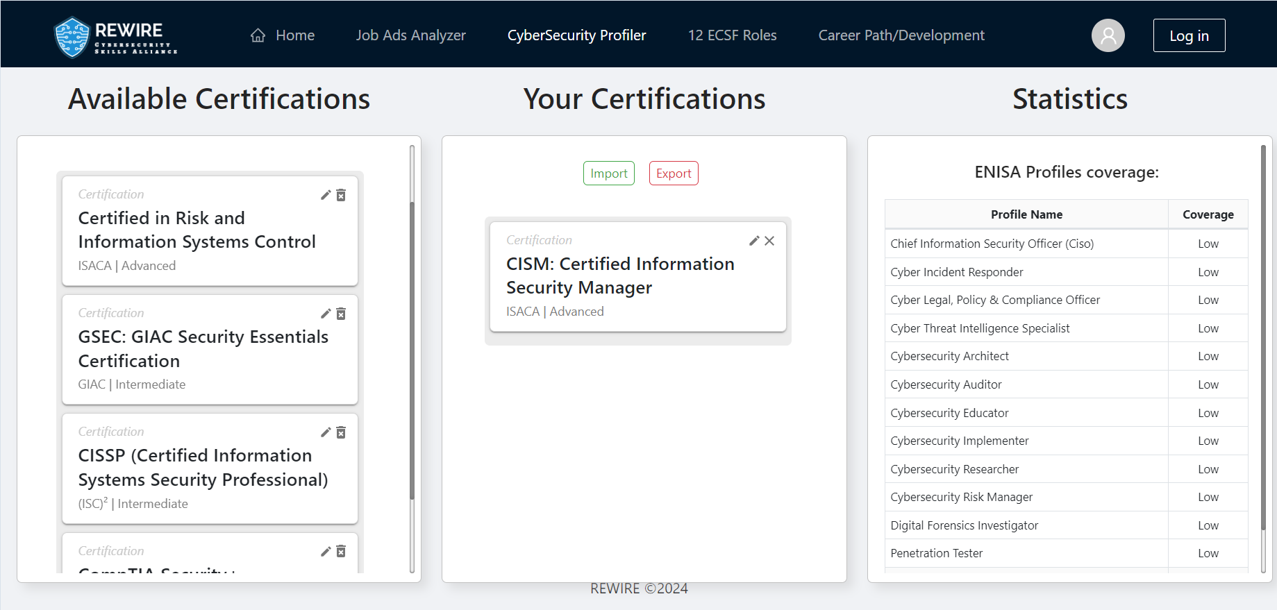
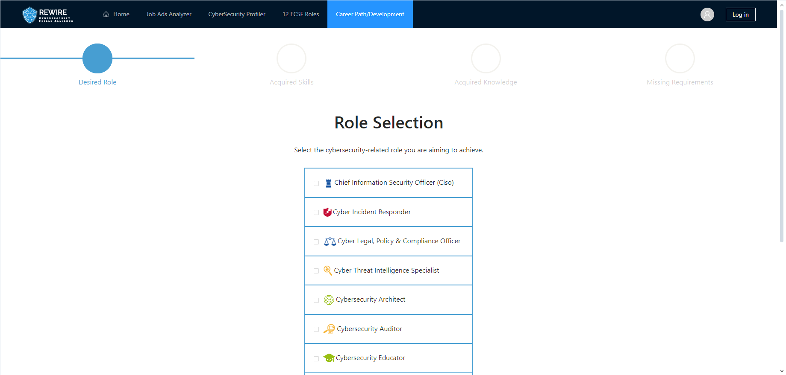
Main outcomes
Creation of:
REWIRE Strategy & Blueprint
CyberABILITY Platform
Job Ads Analyzer
CyberSecurity Profiler
12 ECSF Roles
Career Path / Development
Training
Cyber Range
Online Courses
Certification

Slide 7
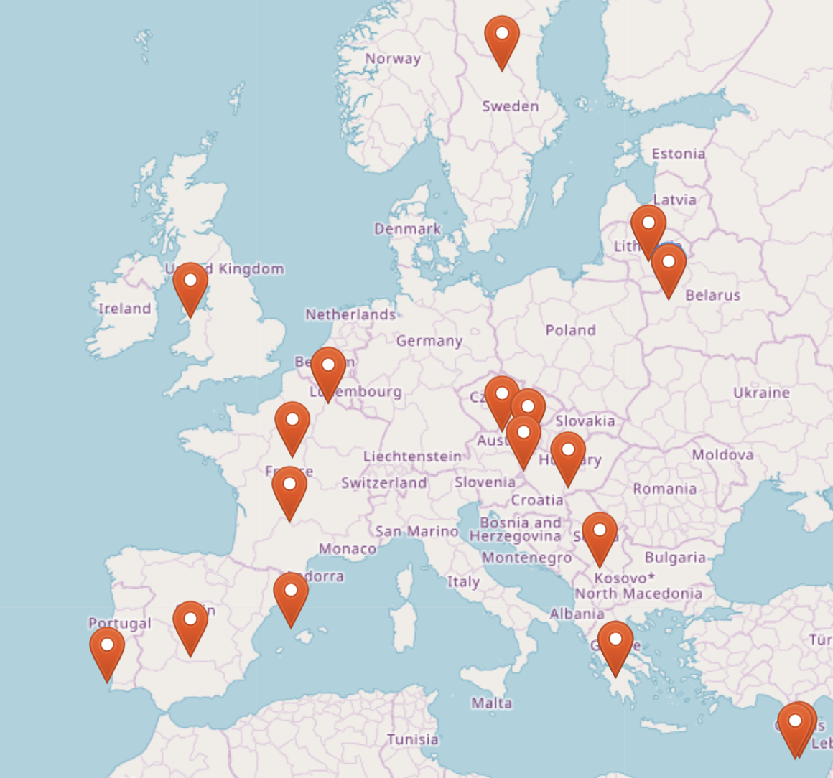
Introduction – General Info
Participants map
Title: Cybersecurity Skills Alliance – A New Vision for Europe: REWIRE
Funding Scheme: EU Erasmus+ Programme
Consortium: 25 partners from Academia and VET, Cybersecurity industry, non-cyber industries, Certification partners, umbrella organizations
Duration: 4 years, November 2020 – October 2024
EU GRANT: ~4M€
Outreach: 26 EU countries and 160 stakeholder organizations
Builds upon: 4 cybersecurity pilot projects CONCORDIA, SPARTA, ECHO, CyberSec4Europe

Slide 8
CyberABILITY Platform
Addressing the evolving needs of the cybersecurity sector

Slide 9
CyberABILITY Platform – Cybersecurity Jobs Analyzer
Database for adding and filtering job advertisements
Identifies and analyzes specific cybersecurity skills required for various roles
Visual map representation of the database
Uses Machine Learning to display identified skills from job ads
Integrates with the ENISA framework for skills comparison

Slide 10
CyberABILITY Platform – Cybersecurity Jobs Analyzer

Slide 11
CyberABILITY Platform – Cybersecurity profiler
Maps existing curricula, trainings, and certifications to specific roles
Integrates trainings and certifications in compliance with ENISA standards
Recommends courses for specific roles, designs study programs, and maintains a database of educational resources

Slide 12
CyberABILITY Platform – Cybersecurity profiler

Slide 13
CyberABILITY Platform – ECSF Explorer
Interactive exploration of the European Cybersecurity Skills Framework (ECSF)
Explore the 12 ECSF profiles
Notes:
, alternative titles, summary statements, missions, deliverables, main tasks, key skills, key knowledge, and e-competences

Slide 14
CyberABILITY Platform – Career Pathway
Enables individuals to draw a career path / development
Based on the ECSF cybersecurity Roles
Output in pdf format the requirements to reach their desired role

Slide 15
Access the CyberAbility platform here: link: https://rewireproject.eu/cyberability/

Slide 16
Training
Cyber Range, Online Courses, Certification

Slide 17
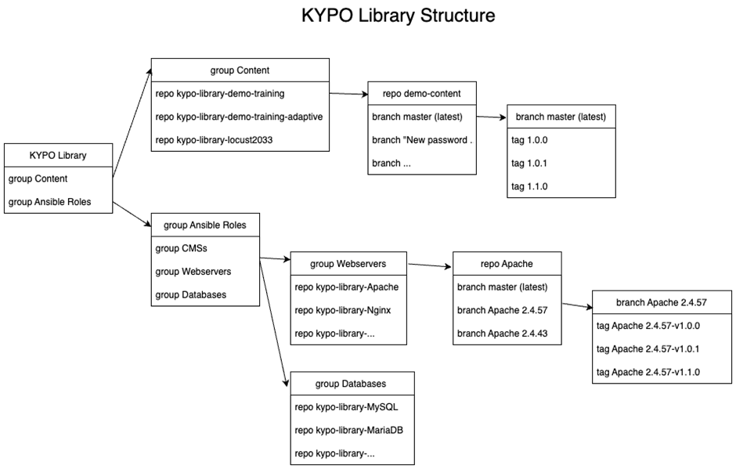
Cyber Range
The REWIRE Cyber Range Platform utilizes services provided by Masaryk University (OpenStack IaaS platform, GitLab) and by CESNET (EINFRA AAI). The REWIRE instance of KYPO Cyber Range Platform is deployed exclusively for the REWIRE project.
The marketplace's foundation rests upon Gitlab, a platform that facilitates change tracking, user role management, and more. A built-in ticketing system streamlines support management and development, while the option to disseminate supplementary information through Gitlab pages enhances communication.
KYPO Library is available at https://gitlab.ics.muni.cz/kypo-library. Access to the system can be requested at support@kypo.cz.

Slide 18
Online Courses
CISO (CHIEF INFORMATION SECURITY OFFICER) COURSE
cybersecurity strategies, managing and implementing policies, and securing information sharing.
CYBER INCIDENCE RESPONDER COURSE
knowledge, skills and attitudes that will enable them to investigate, analyze and respond to cyber incidents.
CYBER THREAT INTELLIGENCE SPECIALIST COURSE
collect, process and analyze data and information to generate reports and communicate them to interested parties.
PENETRATION TESTER COURSE
knowledge, skills and attitudes that will allow them to evaluate the effectiveness of security controls, identify problems, and assess their criticality.

Slide 19
Online Courses
The REWIRE virtual learning environment (VLE) was developed by ReadLab and consists of the 4 REWIRE courses. It can be accessed through this link https://vle.rewireproject.eu or the following QR code.
The landing page provides an initial set of information to the user without registering to the platform (general info about the courses, access to forums & personal account).
By clicking on each course, the users (without registering) can visit a separate page that provides more information about the course. Each course description page includes: A general description of the online course; The learning objectives of the course; An overview of the course syllabus; A short bio of the Course Instructors.

Slide 20
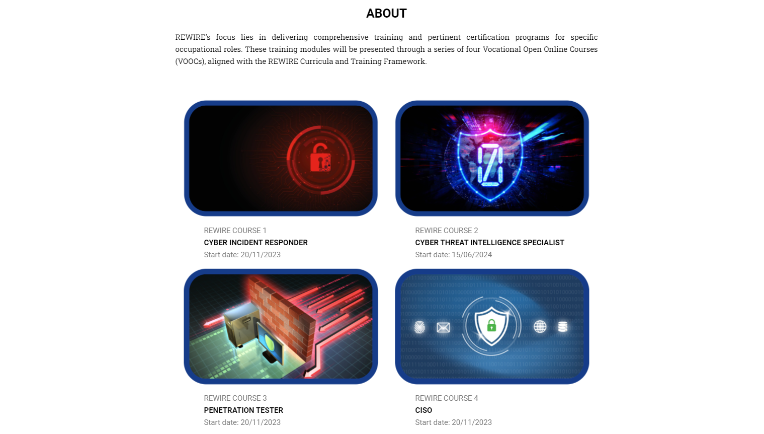
Online Courses – landing page

Slide 21
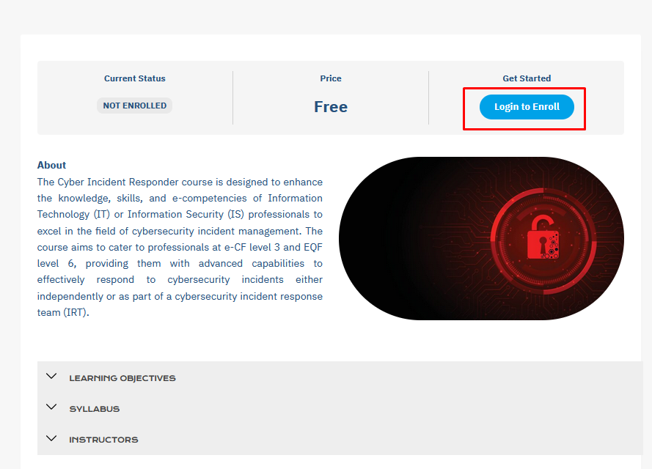
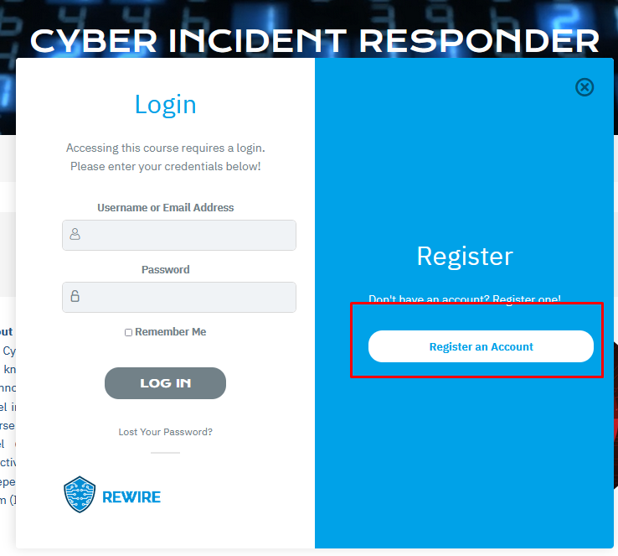
Each user needs to create an account and verify it through a confirmation email on the email address used. Upon verification, the user is able to log in to the REWIRE VLE.

Slide 22
Certification
The Final Certification involves both a Theoretical Exam (comprising questions on the REWIRE Certification Platform) and a Practical Exam (conducted on the REWIRE Cyber Range platform-KYPO) within a controlled environment.
For each one of the certificates, there are specific pre-requisites.

Slide 23
Certification
CISO (Chief Information Security Officer) CertificatION pre-requisites
The professionals should already have a level of IT / IS knowledge and skills at e-CF level 2 - 3 (EQF levels 5-6). Such knowledge could be substantiated by one of the following educational and professional experiences:
• Degree at a university level on Information Technology, Computing, Computer Science, Computer Engineering, Information Technology and Information Systems, Computer Networking and other similar and Fulltime practical experience of at least 4 years in Information Security.
• Vocational Education Degree on Information Technology, Computing, Computer Science, Computer Engineering, Information Technology and Information Systems, Computer Networking and other similar and experience of at least 6 years in IT or IS.
• Professional Certification in an IS/IT subject related to cybersecurity (systems administration, operational procedures, network management, monitoring tools management etc) and fulltime practical experience of at least 6 years in IT or IS.
• Fulltime practical experience of at least 10 years in IT or IS.

Slide 24
Certification
CYBER INCIDENT RESPONDER Certification pre-requisites
The professionals should already have a level of IT / IS knowledge and skills at e-CF level 1 - 2 (EQF levels 3-5). Such knowledge could be substantiated by one of the following:
• Degree at a university level on Information Technology, Computing, Computer Science, Computer Engineering, Information Technology and Information Systems, Computer Networking and other similar.
• Vocational Education Degree on Information Technology, Computing, Computer Science, Computer Engineering, Information Technology and Information Systems, Computer Networking and other similar and experience of at least 2 years in IT or IS.
• Fulltime practical experience of at least 4 years in IT or IS.
• Professional Certification in a IS/IT subject related to cybersecurity incident response (systems administration, operational procedures, network management, monitoring tools management etc) and fulltime practical experience of at least 2 years in IT or IS.

Slide 25
Certification
Cyber Threat Intelligence Specialist pre-requisites
The professionals should already have a level of IT / IS knowledge and skills at e-CF level 1 (EQF level 3). Such knowledge could be substantiated by one of the following:
•Vocational Education Degree on Information Technology, Computing, Computer Science, Computer Engineering, Information Technology and Information Systems, Computer Networking and other similar and experience of at least 2 years in IT or IS.
•Fulltime practical experience of at least 1 year in IT or IS.

Slide 26
Certification
Penetration Tester pre-requisites
The professionals should already have a level of IT / IS knowledge and skills at e-CF level 1 - 2 (EQF levels 3-5). Such knowledge could be substantiated by one of the following:
•Degree at a university level on Information Technology, Computing, Computer Science, Computer Engineering, Information Technology and Information Systems, Computer Networking and other similar.
•Vocational Education Degree on Information Technology, Computing, Computer Science, Computer Engineering, Information Technology and Information Systems, Computer Networking and other similar and experience of at least 2 years in IT or IS.
•Fulltime practical experience of at least 4 years in IT or IS.
•Professional Certification in an IS/IT subject related to cybersecurity (systems administration, operational procedures, network management, monitoring tools management etc) and fulltime practical experience of at least 2 years in IT or IS.

Slide 27
THANK YOU
More information: https://rewireproject.eu
Stay Tuned:
https://twitter.com/RewireP
https://www.linkedin.com/company/rewireproject
https://www.youtube.com/channel/UC2-zInGvTsUOB5F5dM2lHtw

Slide 28
Get in touch!
Manos Athanatos, Technical University of Crete, Greece
Fotini Georga, LRQA Hellas S.A., Greece

